Slide 1


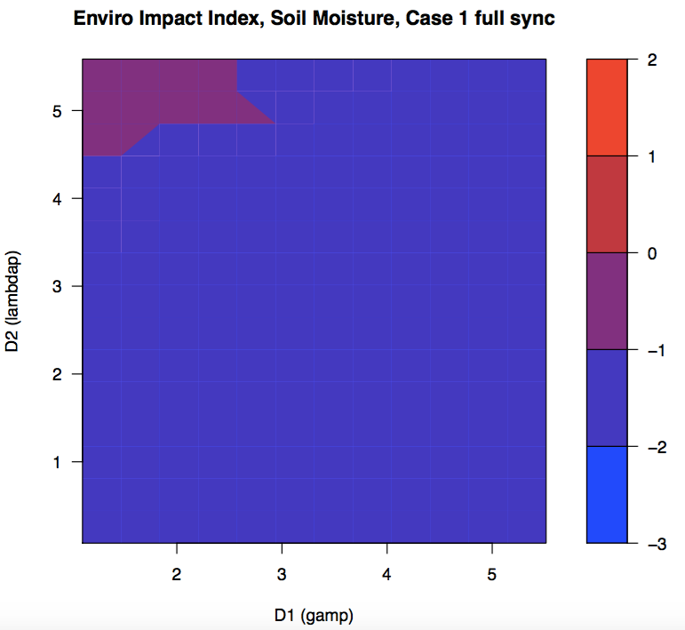
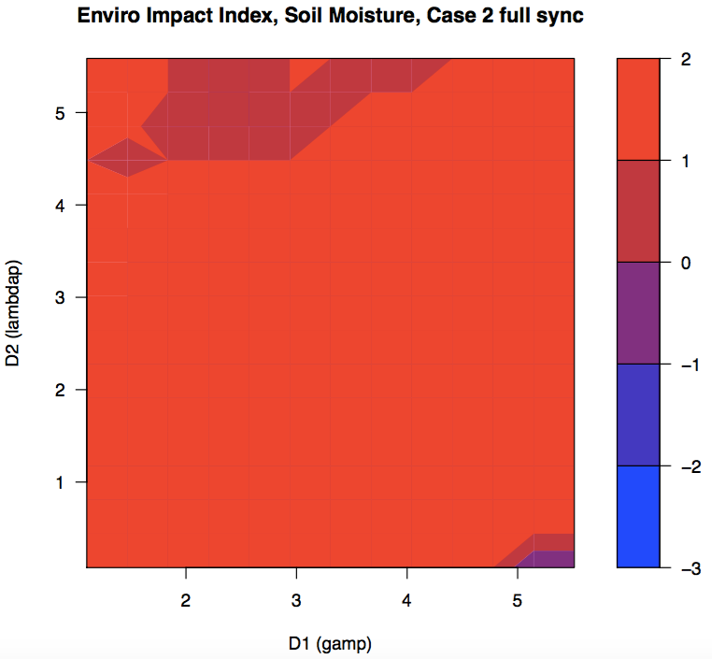
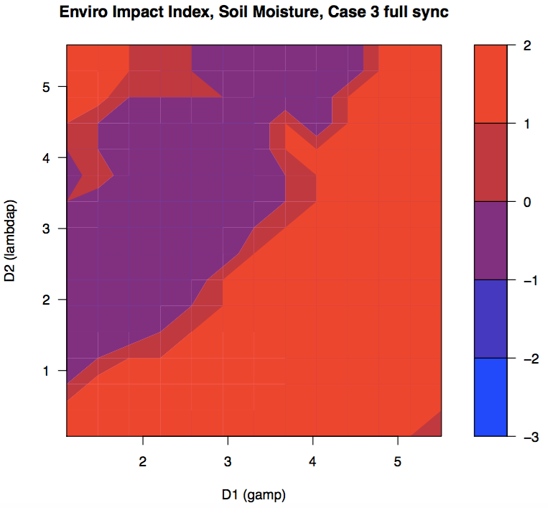
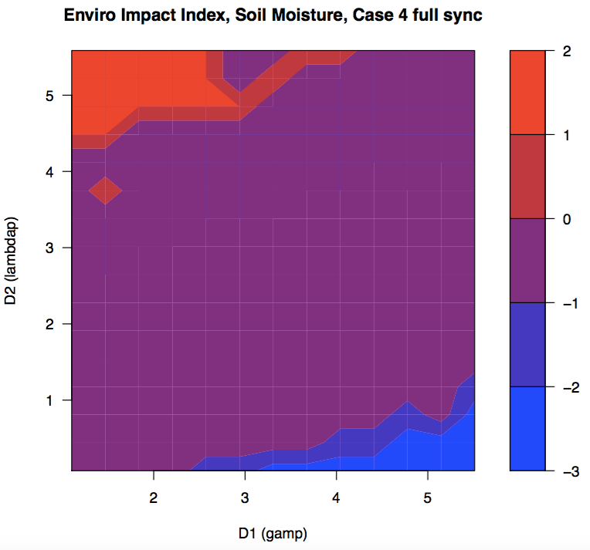
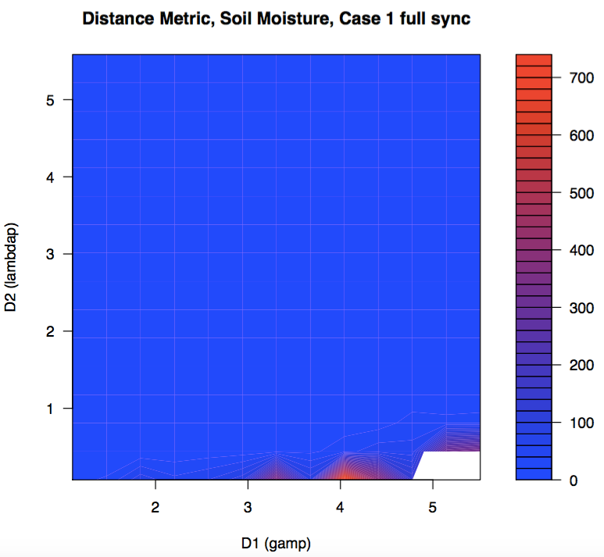
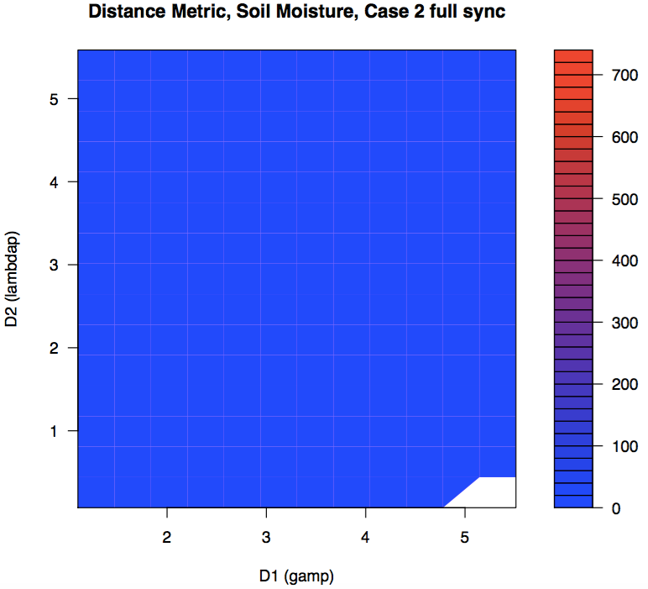
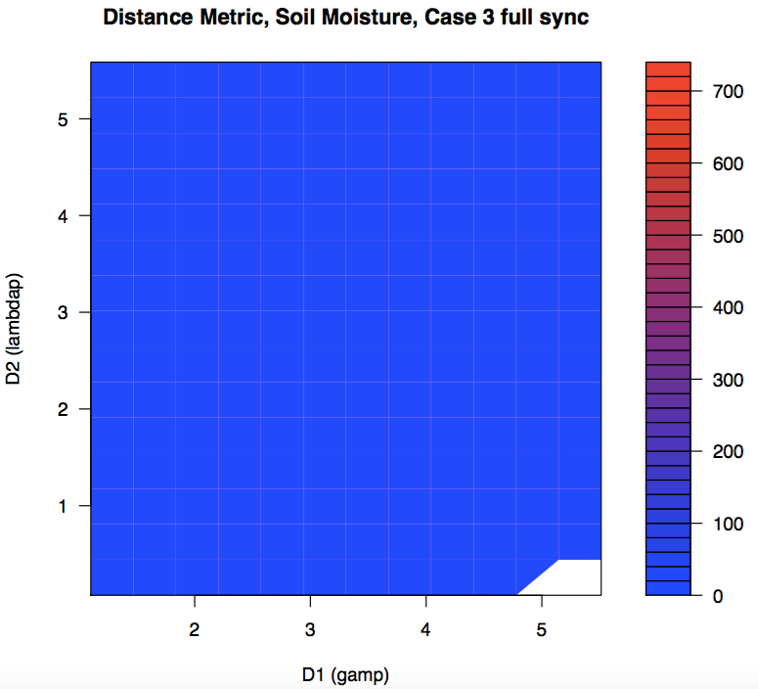
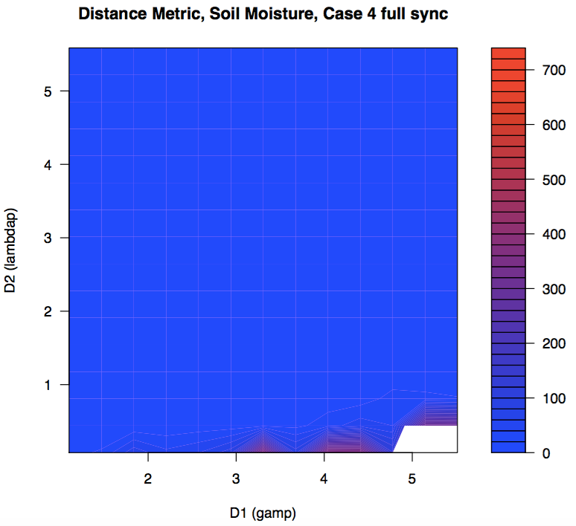
Sustainability and Feasibility of Irrigation Practices
Minghui Zhang; Sally Thompson, PhD
University of California, Berkeley
Introduction
Results and Discussion
Results and Discussion
Incorporating anthropogenic activity into “predictions in ungauged basins” (PUB) efforts is essential given the high level of development of many basins.
We explored the effects of irrigation on streamflow dynamics.
Results suggest that different irrigation strategies leave unique fingerprints on a catchment’s streamflow metrics.
Research Questions
How does a given irrigation strategy affect streamflow for a variety of catchment types?
How heavily does irrigation impact water supply sustainability?
An environmental and social impact metric is a weighted sum describing each irrigation technique’s impact on groundwater storage, streamflow volume, and feasibility of agriculture in the area. (Srinivasan et al., 2011)
Method
We modified the Botter et al 2007 soil moisture model to account for four possible irrigation sources and two scheduling synchronicities.
A catchment is described by four soil, three climate properties, and recession constant.
Circle areas of note
Three areas of this plot represent exception cases, and should not be considered:
Irrigation is needed, but less than 50% of the need is met
Irrigation is unnecessary; natural conditions can support agriculture
Streamflow never peaks, and distance metric cannot be calculated
Deficit irrigation triggered at 60% of field capacity was modeled.
Add disc sentence for enviro impact
Conclusions
Add arrows pointing to the exception areas
Circle areas of note
The Euclidean distance metric indicates the degree of change in streamflow caused by a given irrigation regime. (say how well we can predict irrigation given a type of catchment)
Our results provide a first insight into PUB methodologies that could be employed in heavily managed basins.
Next Steps
To expand on our first research question, we will include other realistic irrigation strategies, such as fixed scheduling and the crop coefficient-based scheduling.
Our predictions in irrigation will be validated through comparison with basins (e.g. the Russian River basin) for which irrigation and streamflow details are already known.
We will then use statistical techniques to compute the likelihood of each irrigation practice in a set of potential irrigation scenarios using streamflow data alone.
A distance metric describes the magnitude of streamflow change attributable to irrigation:
Irrigation is feasible outside of these exception cases. These areas generally experience minimal change in streamflow dynamics compared to natural conditions.
Contact
References
Minghui Zhang
University of California, Berkeley
Email: minghuiz@berkeley.edu
Phone: (510) 883 4186
Botter, G; Porporato, A; Rodriguez-Iturbe, I; Rinaldo, A. “Basin-scale soil moisture dynamics and the probabilistic characterization of carrier hydrologic flows: Slow, leaching-prone components of the hydrologic response”. Water Resources Research, 43, 2007.
Porporato, Amilcare; Daly, Edoardo; and Rodriguez-Iturbe, Ignacio. “Soil water balance and ecosystem response to climate change”. The American Naturalist, 164:5, 2004.
Srinivasan, V; Lambin, EF; Gorelick, SM; Thompson, BH; and Rozelle, S. “The nature and causes of the global water crisis: Syndromes from a meta-analysis of coupled human-water studies”. Water Resources Research, 48: 2011.

